Slide 1



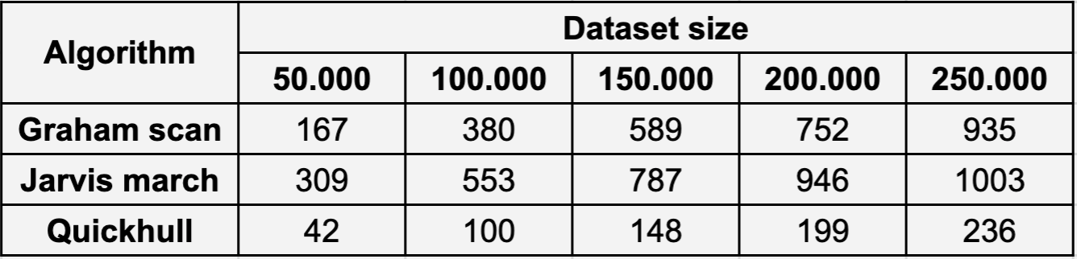
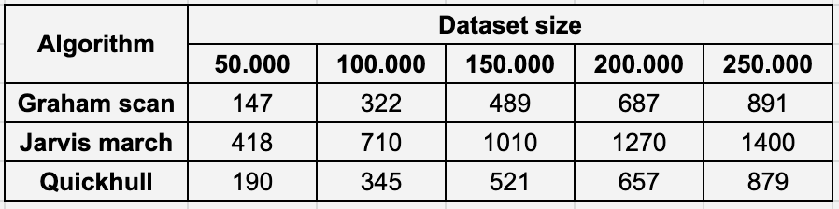

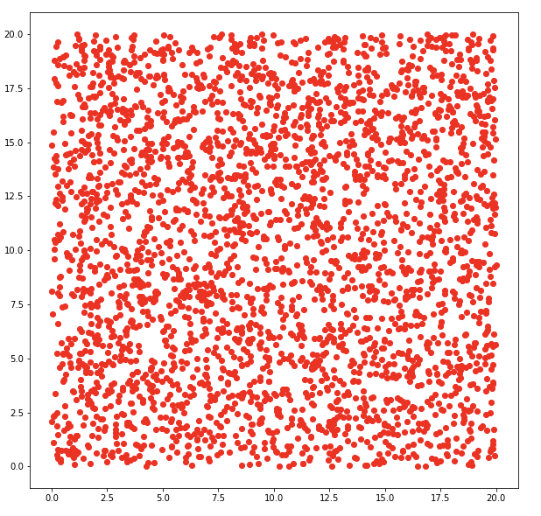
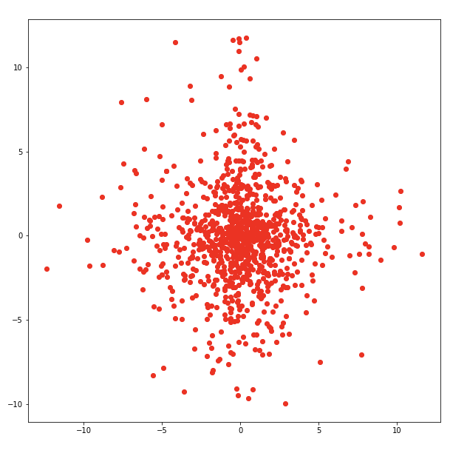
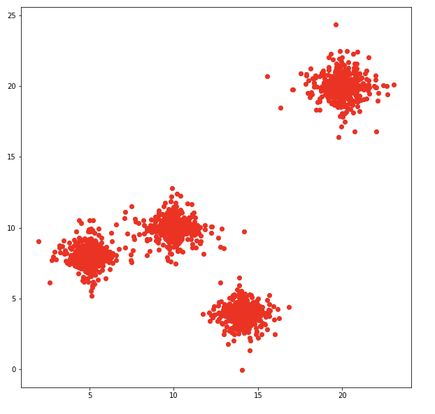
Institute of Computer Science
Comparative Analysis of Convex Hull Algorithms
Anhelina Lohvina
https://github.com/angelcoder/algorithmics_project
Abstract
Jarvis march
Time taken to compute convex hull in case of different data distributions
This research project aims to compare three most popular convex hull algorithms. Besides, this work contains the results of algorithms speed comparison in different conditions. Finally, animations are build in order to show each algorithm’s work.
3. Using stack data structure the algorithms removes concavities in the boundary efficiently, by detecting the clockwise direction of traversal. Scanning ends when p0 is reached.
Jarvis used the idea of looking for a convex hull sequentially, counterclockwise, starting from a certain point [4].
Uniform distribution
Algorithm idea:
1. finding the lowest point with min x-coordinate.
Introduction
2. the next point is selected as the point that beats all other points at counterclockwise orientation, i.e., next point is q if for any other point r, we have “orientation(p, r, q) = counterclockwise”
The convex hull (CH) of a set of points is the smallest convex set that contains the points.
A finite point set convex hull computing is widely adopted in pattern recognition, image processing, nesting problems. Convex hull algorithms are widely used in geoinformatics and geographic information systems. [1]
Many algorithms are used for finding convex hulls. In this research some of existing algorithms will be discussed which are Graham’s Scan Algorithm, Jarvis’s March or Gift wrapping Algorithm (Yaacoub etc 2006 and Choi 2007), Quick hull Algorithm (Mucke 2009) . [2]
Problem definition: given a set S of n two-dimensional points, compute its convex hull H(S).
The running time of the Graham procedure is O(n lg n). The while-loop will take O(n) time. While the sorting of polar angles will take O(n lg n) time, from which follows the general asymptotics of the Graham procedure.
Laplas distibution
Quickhull algorithm
Cluster distribution
It is a divide and conquer algorithm similar to QuickSort.
Algorithm idea[5]:
1. divide the points in two subsets: upper and lower
2. find maximal distance point to the division line for both subsets, ignore points inside triangle and repeat it.
The inner loop checks every point in the set S, and the outer loop repeats for each point on CH. Hence the total run time is O(nh). The run time depends on the size of the output, so Jarvis's march is an output-sensitive algorithm. However, because the running time depends linearly on the number of hull vertices, it is only faster than O(nlog n) algorithms such as Graham scan when the number h of hull vertices is smaller than log n. [6]
From the data above we can see that Quickhull performed the best in case of non-cluster distributions. Jarvis march is the slowest one in all three cases. And Graham scan appeared to win with a dispersed data.
These results show that the right choice of algorithm for specific data can increase the computational speed.
Graham scan
Graham scan algorithm
Experiments
Graham showed [3], that if we preliminary sort all the points, the boundary points may be found during linear time.
The algorithms consists of three steps:
Conclusions
Different data sets were given to 3 algorithms to test their behavior and speed.
The research showed that all three algorithms behave differently applied to a variety of points distributions. Hence, it can be concluded that a hybrid algorithm can be used to suit any data distribution and size.
3. Recurse until no more points are left
Testing datasets distribution examples for convex hull algorithms analysis
1. finding the pivot point, that is guaranteed to be in CH. E.g., a point p0 with the smallest y-value.
References
References
[1] R.V. Chadnov, A.V. Skvortsov. Convex hull algorithms review, 2004
[2] Muhammad Sharif. A new approach to compute convex hull, 2011
[3] Graham RL. An efficient algorithm for determining the convex hull of a finite planar set, Information Process. Letters, 1972, v. 1, p. 132-133.
[4] Jarvis A. On the identification of the convex hull of a finite set of points in the plane, Information Processing Letters, 1973, v. 2, p.18-21.
[5] https://en.wikipedia.org/wiki/Quickhull
[6] https://en.wikipedia.org/wiki/Gift_wrapping_algorithm
2. ordering other n-1 points by polar angle with p0 in terms of increasing angle.
Step 2 takes O(h) time, however, the search of the right orientation takes O(n). Hence, it has O(nh) time complexity. Since all n points of initial set may belong to convex hull and Jarvis algorithm takes linear time to find every point the total speed of algorithm is O(n*n) in the worst case.
Uniform Laplas Cluster

Slide 2
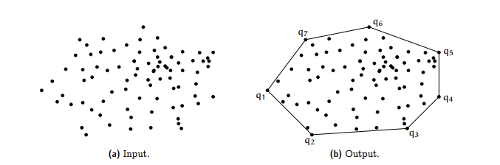
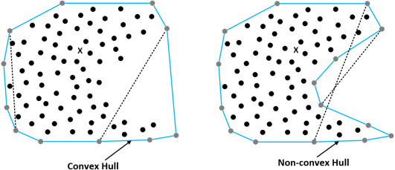
Problem definition

Slide 3
Algorithms
Graham scan
Quickhull algorithm
Jarvis march
O(n log n)
O(n log n)
O(nh)

Slide 4
Experimental comparison of algorithms
Examples of testing data used in convex hull algorithms analyzing
Uniform distribution
Laplas distribution
Cluster distribution

Slide 5
Results

Slide 6

Thank you for your attention!
source: https://www.google.com/url?sa=i&url=https%3A%2F%2Fgfycat.com%2Fancientimperfectcarpenterant&psig=AOvVaw1Qiiax-GCv2ZS5idPs94oj&ust=1642799351277000&source=images&cd=vfe&ved=0CAsQjRxqFwoTCPD8-dCewfUCFQAAAAAdAAAAABAu

